Slide 1

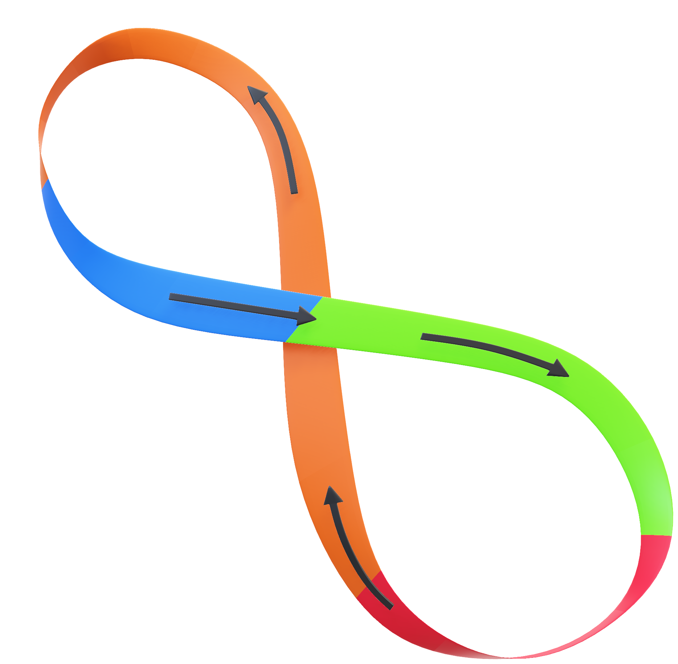
Tortoise Automate
Visual Workflow Automation Tool
Tortoise Squad Team
@state street
October 2023

Slide 2

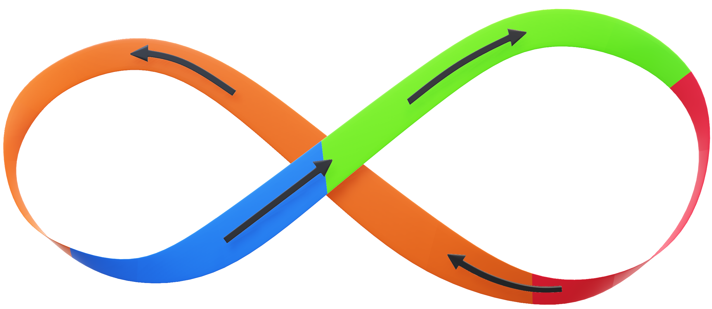
Home – Do not delete this text – Use for Hyperlink
Translate
Build Steps
(2)
(3)
(4)
(1)
Execution
Task

Slide 3


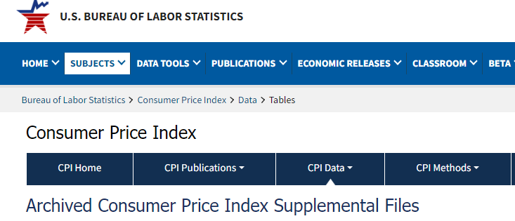
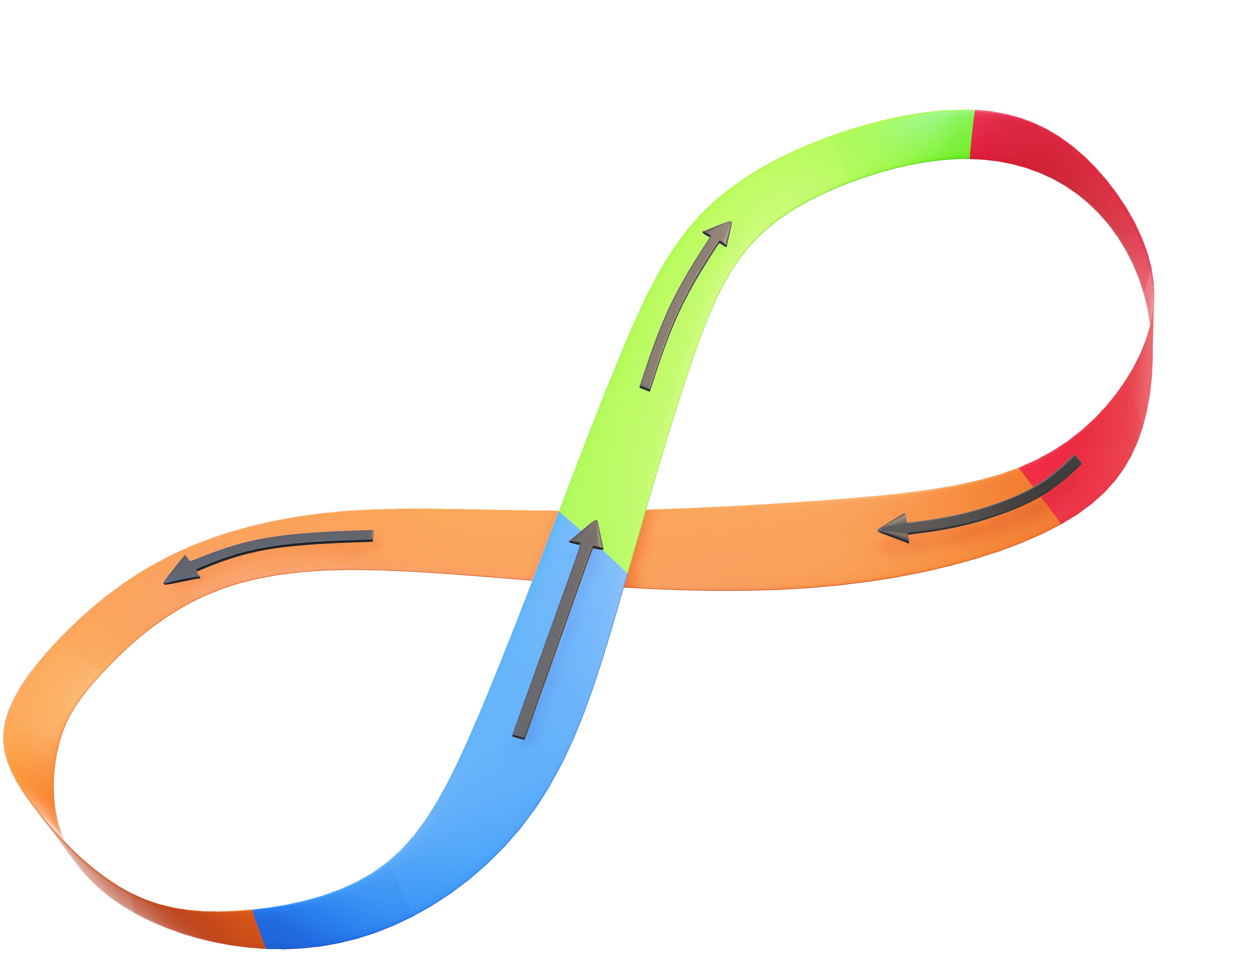
Release – Do not delete this text – Use for Hyperlink
Download CPI Data & Send it to Manager
(1)
Task
Review Daily Work to Get A Routine Task

Slide 4

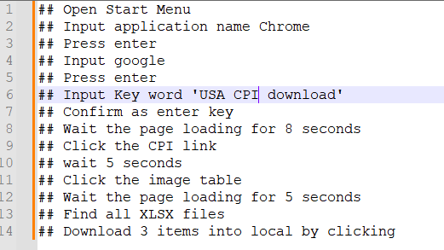
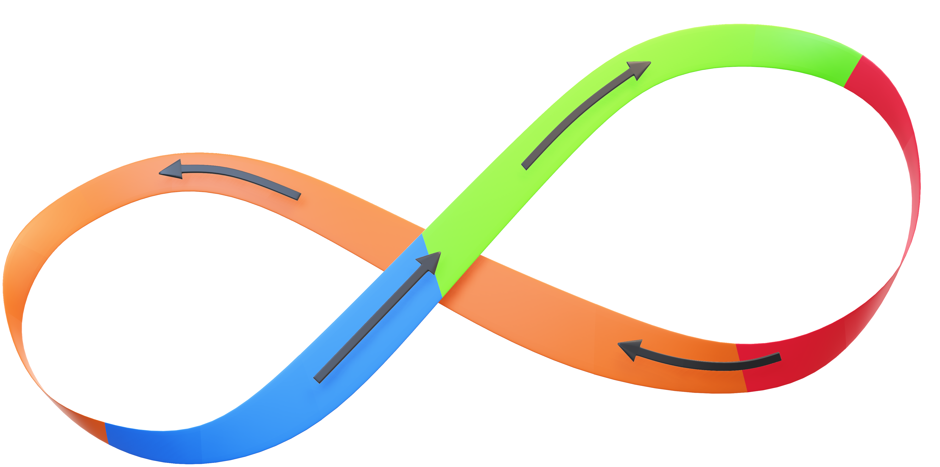
conservation – Do not delete this text – Use for Hyperlink
(2)
Build Step
Describe the Task Step by Step with Natural Language

Slide 5

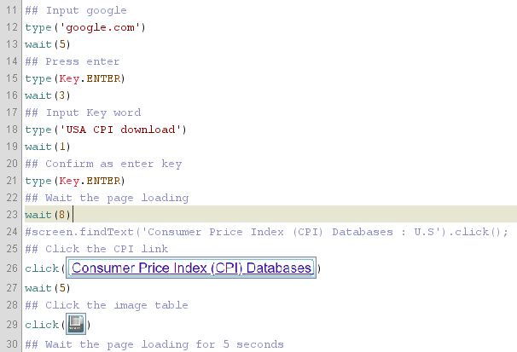
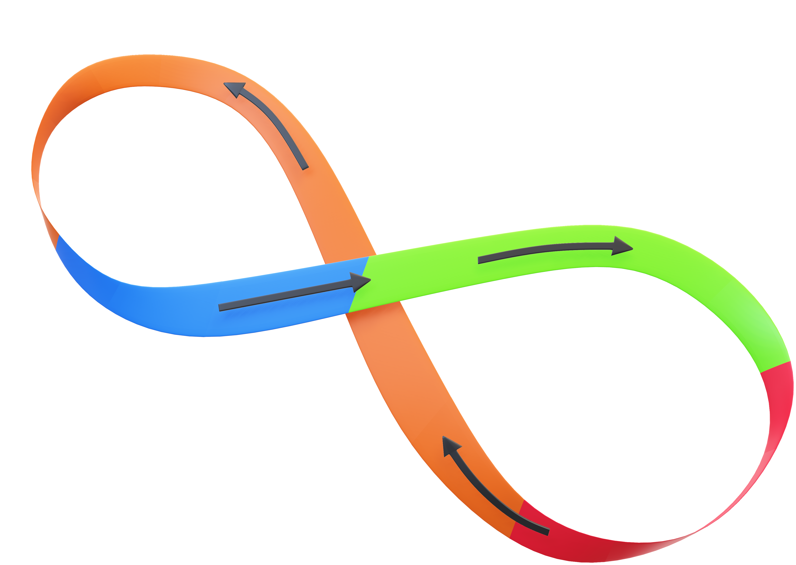
reorganization – Do not delete this text – Use for Hyperlink
Translate
(3)
With Azure OpenAI Service
Translate into Python Script

Slide 6

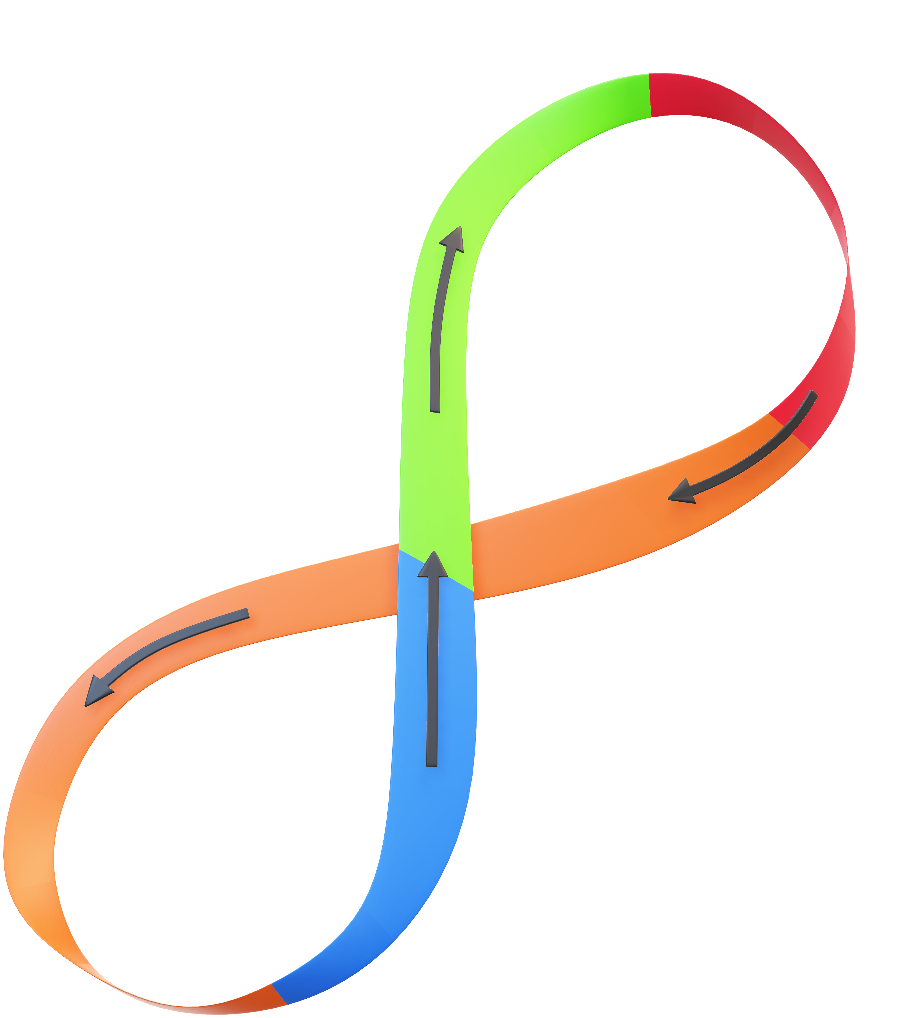
Growth – Do not delete this text – Use for Hyperlink
(4)
Execution
Run the automate task
- Jython (Python run on JVM)
- OpenCV
- Robot Framework
- Tesseract-OCR

Slide 7
Innovation – Do not delete this text – Use for Hyperlink
Component List
Distribution Site – Azure Web Application
https://tortoise-automate.azurewebsites.net
AI Engine – Azure AI Service
https://tortoise-openai-001.openai.azure.com/
Desktop Tool – Java Swing GUI Application

Slide 8


Questions?
Tortoise Squad Team
@state street
October 2023

